Slide 1
Biomass Energy
Biomass energy is a renewable energy source that comes from organic materials, such as wood, agricultural waste, and municipal solid waste.
Biomass can be used to generate electricity, heat, and transportation fuels.
Advantages:
Renewable:
Biomass energy is a renewable energy source, meaning that it is replenished naturally over time.
Carbon Neutral:
When biomass is burned, it releases carbon dioxide into the atmosphere, but this carbon dioxide is offset by the carbon dioxide absorbed by the plants during their growth, making biomass energy carbon neutral.
Reduce Landfill Waste:
Biomass energy can be produced from organic waste materials, reducing the amount of waste sent to landfills and therefore reducing greenhouse gas emissions.
Energy Independence:
Biomass energy can be produced locally, reducing dependence on foreign oil and increasing energy independence.
Disadvantages:
Land Use:
The production of biomass can require large amounts of land, which can compete with other land uses, such as agriculture and conservation.
Greenhouse Gas Emissions:
Biomass energy can release other greenhouse gases besides carbon dioxide, such as methane, during production and transportation.
Air Pollution:
The burning of biomass can release pollutants, such as particulate matter, into the air.
Cost:
The cost of producing biomass energy can be higher than that of fossil fuels, making it less economically competitive.

Slide 2
Biomass conversion technologies
Combustion:
This technology involves burning biomass to produce heat, which can be used to generate electricity, steam, or hot water.
Combustion is one of the most common and widely used biomass conversion technologies.
Gasification:
Gasification involves heating biomass in a low-oxygen environment to produce a gas composed mainly of carbon monoxide, hydrogen, and methane, which can be used to generate electricity or produce biofuels.
Pyrolysis:
Pyrolysis involves heating biomass in the absence of oxygen to produce liquid bio-oil, gas, and solid biochar.
The bio-oil can be used as a fuel for heat and electricity generation or upgraded to produce transportation fuels.
Anaerobic digestion:
This process involves the breakdown of biomass by microorganisms in the absence of oxygen to produce biogas, which can be used to generate electricity or produce biofuels.
The remaining digestate can be used as a fertilizer.
Fermentation:
Fermentation involves using microorganisms to convert biomass into biofuels, such as ethanol or butanol, which can be used as transportation fuels.
Hydrothermal liquefaction:
Hydrothermal liquefaction involves heating biomass in water under high pressure to produce a liquid bio-oil, which can be upgraded to produce transportation fuels.

Slide 3
Biomass Combustion
Advantages:
Renewable energy source:
Biomass is a renewable energy source that is derived from plant matter, which can be grown and harvested sustainably.
Reduced carbon emissions:
Biomass combustion emits less carbon dioxide than the combustion of fossil fuels, which can help to reduce greenhouse gas emissions and mitigate climate change.
Waste reduction:
Biomass combustion can be used to dispose of waste materials, such as agricultural residues, forest residues, and municipal solid waste, which can help to reduce the amount of waste sent to landfills.
Job creation:
The biomass industry can create jobs in rural areas, where biomass resources are often abundant.
Energy security:
Biomass combustion can help to increase energy security by reducing reliance on imported fossil fuels.
Disadvantages:
Air pollution:
Biomass combustion can produce air pollution, including particulate matter, carbon monoxide, and nitrogen oxides, which can have negative health impacts.
Land use:
Growing biomass crops for combustion can require significant amounts of land, which can lead to land use conflicts and competition with food production.
Water use:
Biomass crops may require irrigation, which can lead to increased water use and competition with other water uses.
Cost:
Biomass combustion technology can be expensive to install and maintain, which can limit its uptake.
Sustainability concerns:
Biomass combustion must be managed sustainably to ensure that it does not lead to deforestation, land degradation, or other negative environmental impacts.

Slide 4
Urban waste to energy conversion
Renewable energy source:
Biomass is a renewable energy source that is derived from plant matter, which can be grown and harvested sustainably.
Reduced carbon emissions:
Biomass combustion emits less carbon dioxide than the combustion of fossil fuels, which can help to reduce greenhouse gas emissions and mitigate climate change.
Waste reduction:
Biomass combustion can be used to dispose of waste materials, such as agricultural residues, forest residues, and municipal solid waste, which can help to reduce the amount of waste sent to landfills.
Job creation:
The biomass industry can create jobs in rural areas, where biomass resources are often abundant.
Energy security:
Biomass combustion can help to increase energy security by reducing reliance on imported fossil fuels.

Slide 5
Biomass gasification process
Biomass gasification is a process of converting solid biomass into a combustible gas mixture called syngas (short for synthesis gas) through thermal decomposition in a high-temperature environment with limited oxygen supply.
The syngas produced can then be used for a variety of energy applications such as power generation, heating, and fuel production.
The process of biomass gasification typically involves three stages: drying, pyrolysis, and gasification.

Slide 6
Working of Biomass Gasification system
Drying stage:
In the drying stage, moisture is removed from the biomass feedstock to prevent it from reducing the overall efficiency of the gasification process.
This stage typically occurs at temperatures of around 100°C to 200°C and with limited oxygen supply.
Pyrolysis stage:
In the pyrolysis stage, the dried biomass feedstock is heated to high temperatures (400°C to 600°C) in the absence of oxygen, resulting in the decomposition of the solid biomass into volatile gases, tars, and char.
This stage is also known as the thermal decomposition stage.
Gasification stage:
In the gasification stage, the volatiles produced in the pyrolysis stage are subjected to a controlled combustion process at temperatures between 800°C and 1200°C with limited oxygen supply.
This process produces syngas, which is composed of carbon monoxide, hydrogen, carbon dioxide, and other gases.

Slide 7
Construction of Biomass Gasification Plant
A biomass gasification plant typically consists of the following components:
Biomass feeding system:
This includes a feed hopper and a conveyor system that transports biomass feedstock to the gasification chamber.
Gasifier:
This is the heart of the gasification plant and consists of a high-temperature reactor where biomass is converted into syngas.
Syngas cleaning system:
This system removes impurities such as tars, particulates, and sulfur compounds from the syngas before it is used for energy production.
Gas engine/generator:
This component converts syngas into electricity and/or heat.
Control and monitoring system:
This system is responsible for monitoring and controlling the gasification process to ensure efficient and safe operation.

Slide 8
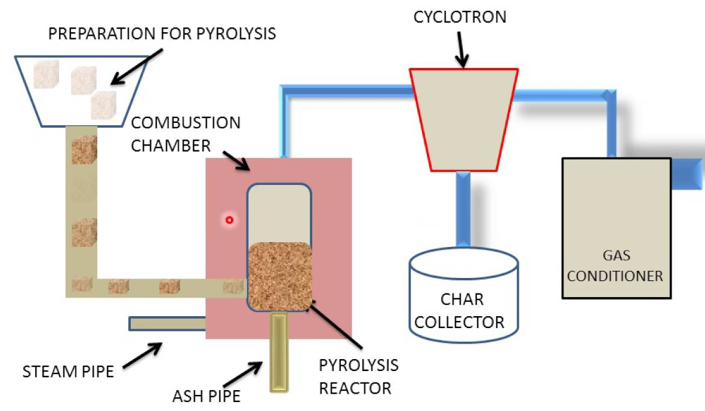

Slide 9
Other forms of Energy
Nuclear energy
Ocean energy
Geothermal energy
Nuclear energy:
This is the energy released during nuclear reactions, either through fission or fusion of atomic nuclei.
Nuclear fission is the splitting of atomic nuclei into smaller fragments, which releases a large amount of energy in the form of heat.
Nuclear fusion is the combination of atomic nuclei to form larger nuclei, which also releases a large amount of energy.
In contrast, nuclear energy does not produce carbon dioxide or other greenhouse gases during electricity generation.
However, nuclear power plants do produce nuclear waste, which is radioactive and can be hazardous to human health and the environment.
The storage and disposal of nuclear waste is a significant challenge for the nuclear industry.
difference between nuclear energy and the combustion of fuels is the amount of energy that can be generated.
Nuclear reactions release a much larger amount of energy per unit mass than combustion reactions.
This means that nuclear power plants can generate a large amount of electricity with a relatively small amount of nuclear fuel.

Slide 10
Working of Nuclear Energy
Nuclear energy is generated through a process called nuclear fission, which involves splitting the nucleus of an atom.
Here are the basic working principles of nuclear energy:
Fuel:
Nuclear reactors use a specific type of fuel, such as uranium-235, which is a radioactive element.
The fuel is enriched to increase the concentration of the radioactive isotope.
Control rods:
In order to control the rate of nuclear fission, control rods made of a material that absorbs neutrons are used.
The rods are inserted into the reactor core to slow down or stop the reaction.
Moderator:
A moderator is used to slow down the neutrons released during nuclear fission.
This is typically done using water or graphite, which can absorb some of the energy of the neutrons and slow them down.
Heat exchange:
The heat generated by nuclear fission is used to produce steam, which then drives a turbine to generate electricity.
In order to transfer heat from the reactor to the turbine, a heat exchange system is used.
Coolant:
A coolant, typically water, is used to transfer heat from the reactor to the heat exchanger.
The coolant absorbs heat from the reactor and carries it to the heat exchanger, where it heats the water to produce steam.
Safety systems:
Nuclear reactors have a variety of safety systems in place to prevent accidents and minimize the risk of radiation exposure.
These may include backup cooling systems, emergency shutdown systems, and radiation monitoring systems.

Slide 11
Other forms of Energy
Nuclear energy
Ocean energy
Geothermal energy
Applications of Nuclear energy:
Electricity generation:
One of the most significant applications of nuclear energy is for electricity generation.
Nuclear power plants use nuclear reactions to generate heat, which is used to produce steam that drives turbines to generate electricity.
Nuclear power is a reliable and efficient source of electricity, and many countries around the world have developed nuclear power programs to meet their energy needs.
Industrial applications:
Nuclear energy is also used in a variety of industrial applications.
it can be used for the sterilization of medical equipment and food products, as well as for the production of isotopes used in research and industry.
Nuclear energy can also be used to power ships and submarines, as well as for space exploration missions where conventional energy sources are not practical.

Slide 12
Ocean energy
Ocean energy refers to the energy that can be harnessed from the motion of the ocean's tides, waves, and currents.
There are several methods for converting ocean energy into usable forms of energy, including
Tidal energy:
Tidal energy is generated by harnessing the power of ocean tides.
Tidal power plants typically use large turbines that are placed in the path of tidal flows, such as estuaries or tidal lagoons.
As the tide rises and falls, the water flows through the turbines, generating electricity.
Wave energy:
Wave energy: Wave energy is generated by capturing the motion of ocean waves.
There are several methods for generating wave energy, including oscillating water columns, point absorbers, and overtopping devices.
Each of these methods involves capturing the energy of the waves and converting it into usable electricity.
Ocean thermal energy conversion (OTEC):
This is a method of generating energy from the temperature difference between warm surface water and cold deep water in the ocean.
OTEC systems typically use a heat exchanger to transfer heat from warm surface water to a working fluid, which is then used to generate electricity

Slide 13
Applications of Ocean energy:
Electricity generation:
One of the most significant applications of ocean energy is for electricity generation.
Tidal energy and wave energy converters are two popular methods of harnessing the energy from the ocean to generate electricity.
Tidal power plants use the gravitational pull of the moon and the sun to create tidal currents, which can be harnessed to generate electricity.
Wave energy converters use the kinetic energy of ocean waves to generate electricity.
Desalination:
Ocean energy can also be used for desalination, which is the process of removing salt and other minerals from seawater to make it safe for human consumption.
Desalination is becoming increasingly important as freshwater resources become more scarce in many parts of the world.
Ocean energy can be used to power the desalination process, making it a sustainable solution for meeting water demands.
Climate control:
The ocean plays an important role in regulating the Earth's climate.
Ocean energy can be used to pump cold water from the ocean's depths to the surface, which can help to cool the Earth's atmosphere and reduce the effects of global warming.
This method is known as ocean thermal energy conversion (OTEC) and has the potential to generate large amounts of electricity while also helping to mitigate the effects of climate change.

Slide 14
Geothermal energy
Geothermal energy is a form of renewable energy that is derived from the heat of the Earth's interior.
This heat can be harnessed and used to generate electricity or heat buildings.
Here is a step-by-step process for harnessing geothermal energy
Identify geothermal resources:
Geothermal resources are typically found in areas where the Earth's crust is thin and there is magma or hot rocks near the surface.
These resources can be identified using geological surveys and other methods.
Once a geothermal resource has been identified, a well is drilled to access the hot water or steam beneath the surface.
Extract geothermal fluids:
Once the well has been drilled, hot water or steam is extracted from the geothermal reservoir.
The fluids are then transported to the surface using pumps or natural pressure.
Convert geothermal fluids into electricity:
The extracted geothermal fluids are then used to generate electricity.
This is typically done using a binary cycle power plant, which involves using a heat exchanger to transfer heat from the geothermal fluids to a secondary fluid.
The secondary fluid is then vaporized, which drives a turbine and generates electricity.
Use geothermal fluids for heating:
In addition to generating electricity, geothermal fluids can also be used for heating buildings or for other industrial processes.
This is typically done using a direct-use system, which involves using the geothermal fluids directly for heating.

Slide 15
Applications of Geothermal energy:
Electricity generation:
One of the most significant applications of geothermal energy is for electricity generation.
Geothermal power plants use the heat from the Earth's crust to produce steam, which drives turbines to generate electricity.
Geothermal power is a reliable and sustainable source of electricity that can be used to meet the energy needs of communities and industries.
Heating and cooling:
Geothermal energy can also be used for heating and cooling buildings.
Ground-source heat pumps use the stable temperature of the Earth's crust to heat and cool buildings, reducing energy costs and greenhouse gas emissions.
Geothermal heating and cooling systems can be used in homes, commercial buildings, and industrial facilities.
Agriculture and aquaculture:
Geothermal energy can also be used for agriculture and aquaculture.
The heat from geothermal sources can be used to warm soil, promoting plant growth and increasing crop yields.
Geothermal energy can also be used to warm water for aquaculture, creating ideal conditions for fish and other aquatic species to thrive.

